Slide 1
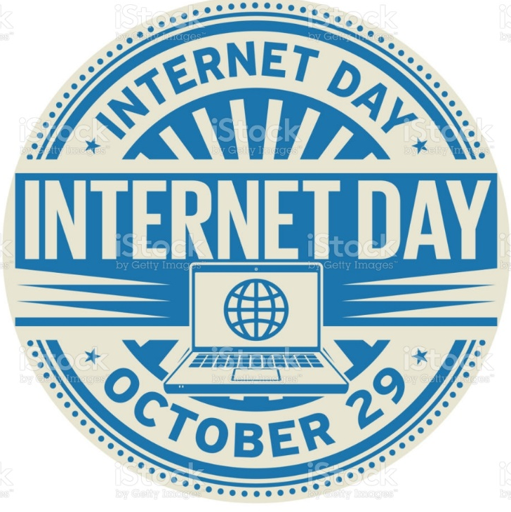


By:
Vedaanth
Senthil
Uploaded by Team Philomath

Slide 2

WHAT IS INTERNET
The Internet is a global web of computers connected to each other by wires, (mostly phone lines). If you look at a map of big cities, smaller towns, and scattered houses, each is connected with roads, railways, etc.. This is like the Internet, except with the Internet, wires connect computers. The Internet is a superhighway.

Slide 3

HISTORY OF INTERNET
1968 - DARPA (Defense Advanced Research Projects Agency) contracts with BBN (Bolt, Beranek & Newman) to create ARPAnet
1977: 111 hosts on Internet
1981: 213 hosts
1983: 562 hosts
1984: 1,000 hosts
1986: 5,000 hosts
1987: 10,000 hosts
1989: 100,000 hosts
1992: 1,000,000 hosts
2001: 150 – 175 million hosts
2002: over 200 million hosts
By 2010, about 80% of the planet will be on the Internet
INTERNET GROWTH TRENDS

Slide 4
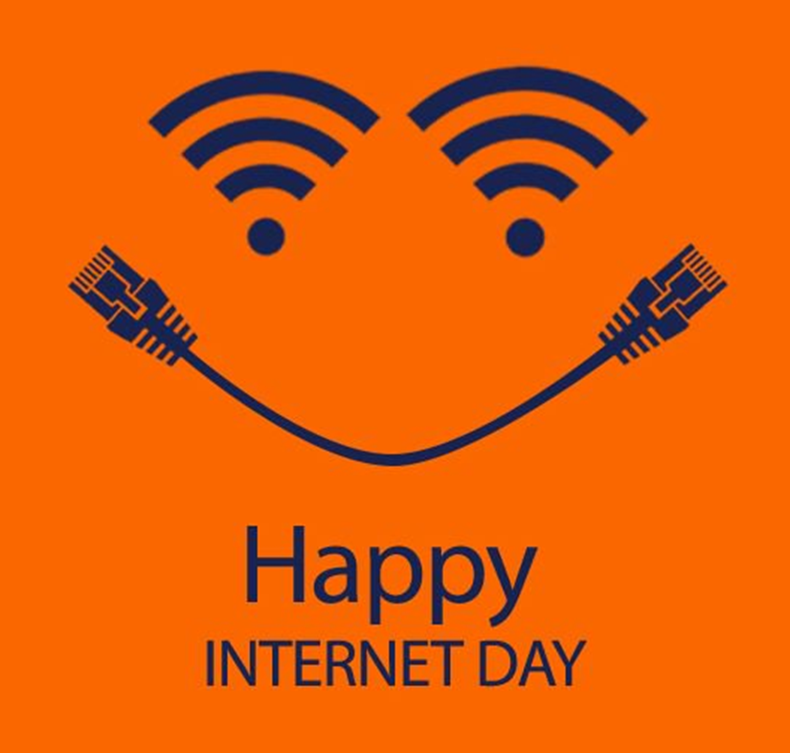
WHEN IS INTERNATIONAL INTERNET DAY CELEBRATED
Since the year 2005 the International Internet Day has been famously
celebrated on 29th October to commemorate a momentous day in the history of telecommunications and technology.
This was the event of the sending of the first message, first electronic message which was transferred from one computer to another in 1969.

Slide 5


WWW
The World Wide Web
Commonly known as the web, is an information system
where documents and other web resources are identified by uniform resource locators which may be interlinked by hypertext and are accessible over the internet.

Slide 6













USES OF INTERNET
E-mail
Research
News
Searching Data/Information
Games
Reading stories
Shopping
Studying Data/Information

Slide 7

Rules to be maintained during surfing on the internet
Keep Personal Information Professional and Limited.
Keep Your Privacy Settings On.
Practice Safe Browsing.
Make Sure Your Internet Connection is Secure.
Be Careful What You Download.
Choose Strong Passwords.
Be Careful Who You Meet Online.
Keep Your Antivirus Program Up To Date.
Enable “do not track” in your browser.
Clear your web browser cache and cookies.
Turn on private browsing.
Use a VPN.

Slide 8
INTERNET TERMS
WWW
Browser
Search Engine
URL
Domain
html

Slide 9


